Slide 1


UNIVERSITY OF PADUA
UNIVERSITA’ DEGLI STUDI DI PADOVA
Designing an accessibility learning toolkit -
Bridging the gap between guidelines and implementation
Department of Mathematics “Tullio Levi-Civita”
Master Degree in Computer Science
Graduate: Gabriel Rovesti – ID: 2103389
Supervisor: Prof. Ombretta Gaggi
Graduation Session: 25/07/2025

Slide 2
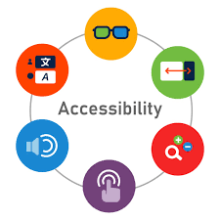

First and not least: Mobile accessibility
Definition: Ability for users to fully perceive, understand, navigate, and interact with digital content regardless of capabilities
The mobile reality:
1.3 billion people worldwide live with disabilities (WHO, 2023)
Mobile-first era: 6.8 billion smartphone users globally
Mobile interfaces create new accessibility barriers: small screens, orientation changes, performances impact
G. Rovesti - Designing an accessibility learning toolkit
2/16

Slide 3
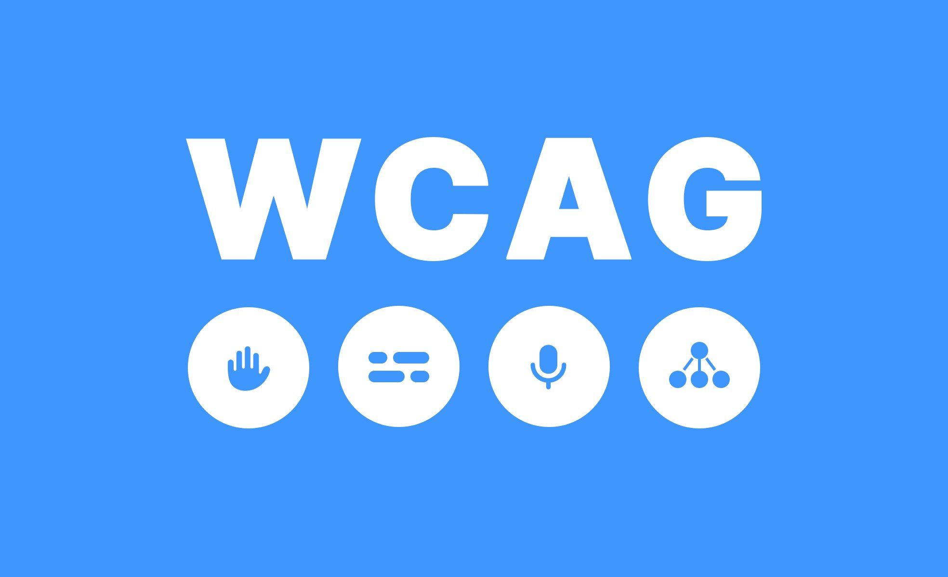
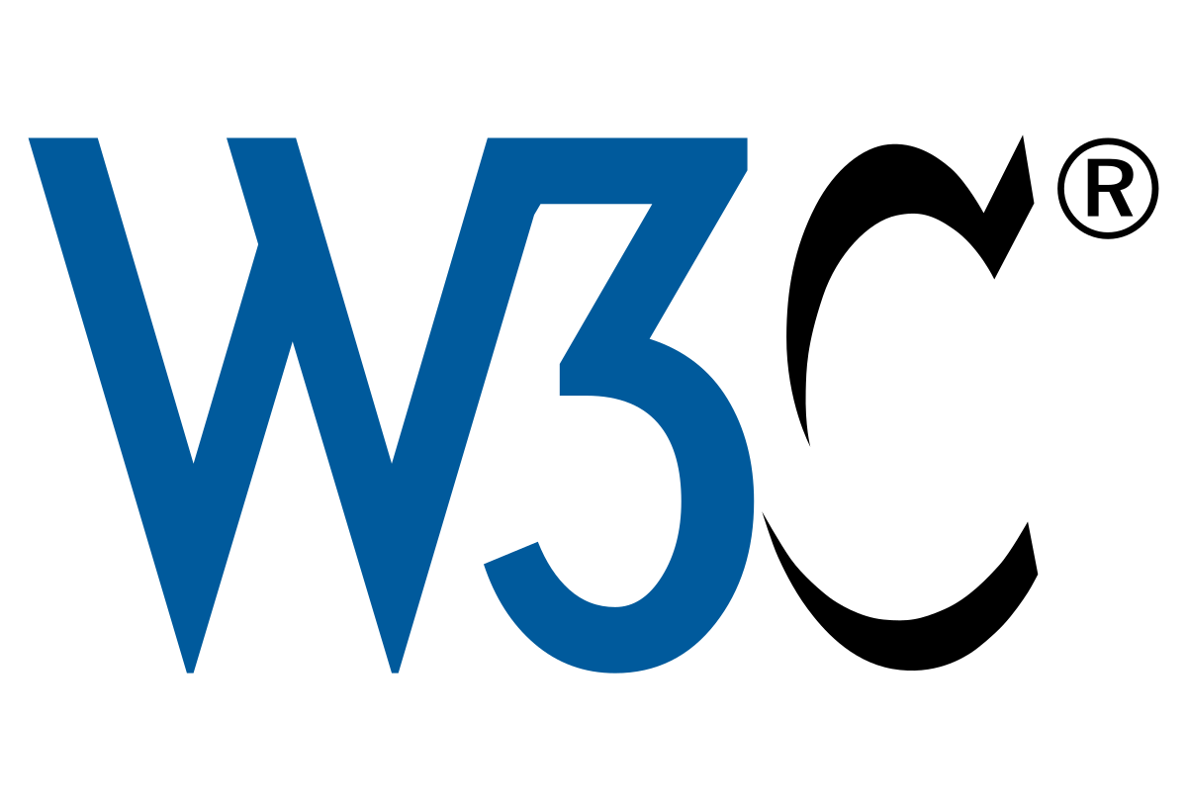
Accessibility guidelines gap
Current standards:
WCAG 2.2 (2023): 4 principles, 3 levels of conformance - web-focused
MCAG (2015): Mobile adaptation - based on WCAG 2.0
WCAG2Mobile (2025): Recent mobile guidance - interpretations only
The problem:
- Implementation void: No comprehensive mobile-native framework since MCAG (2015)
- Guidance gap: Only interpretations, not actionable implementation patterns
- Developer isolation: Scattered resources force
ad-hoc accessibility solutions
Result: Lack of comprehensive accessibility implementation and consistent patterns
G. Rovesti - Designing an accessibility learning toolkit
3/16

Slide 4
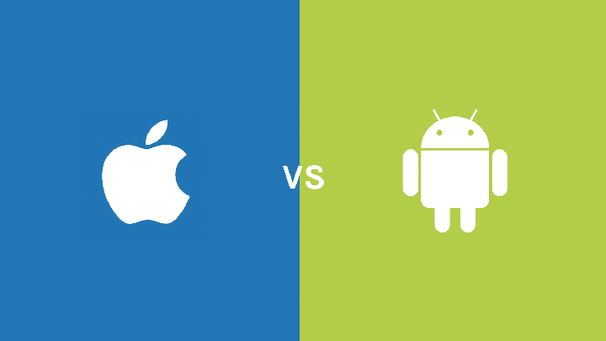
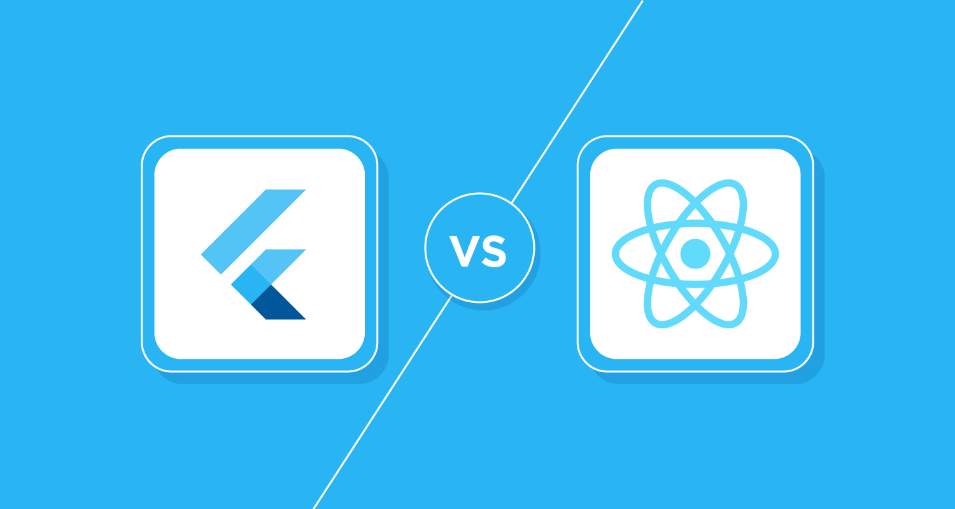
Platform implementation gap
Platform differences:
iOS: VoiceOver, Voice Control, Switch Control
Android: TalkBack, Switch Access
Framework responses:
Flutter: Single accessibility tree, platform adaptation layer
React Native: Platform-specific accessibility props, native bridge
The developer challenge:
Budai (2024): Flutter-focused component accessibility → fragmented knowledge
Gap identified: No comprehensive learning resource bridging platforms
G. Rovesti - Designing an accessibility learning toolkit
4/16

Slide 5
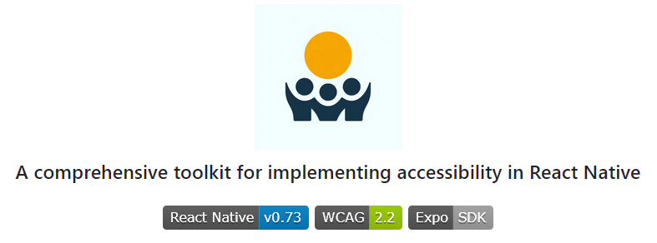
AccessibleHub – Bridging the gap
Research Questions (RQ):
RQ1: Are React Native components accessible by default?
RQ2: Can non-accessible components be made accessible?
RQ3: What's the implementation cost (code overhead)?
AccessibleHub: React Native application tested on both Android and
iOS serving as practical implementation guide for mobile developers
- Every screen analyzed for accessibility patterns + implementation costs
- Developer-first platform bridging WCAG theory to executable code
G. Rovesti - Designing an accessibility learning toolkit
5/16

Slide 6
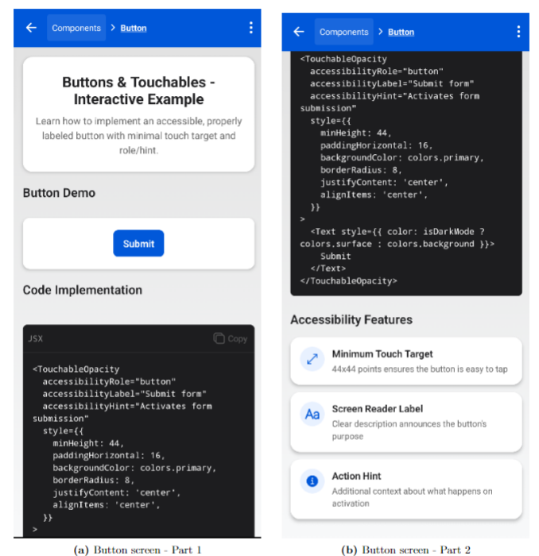
AccessibleHub – Overview
📱From theory...
...to practice! 💻
📀 Live demos (Android & iOS): hands on!
G. Rovesti - Designing an accessibility learning toolkit
6/16

Slide 7
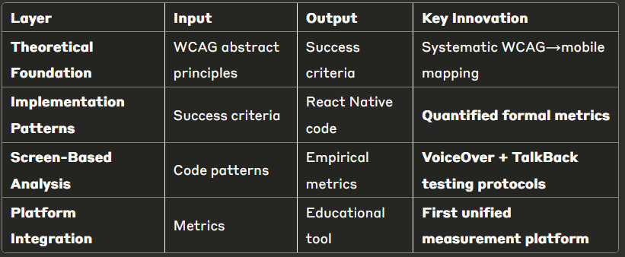
Systematic analysis approach
The transformation challenge: WCAG guidelines are abstract and difficult to implement directly in mobile code
Basic workflow - Enabling data-driven accessibility decisions
Abstract WCAG ➡ Implementation Patterns ➡ Quantified Metrics
G. Rovesti - Designing an accessibility learning toolkit
7/16

Slide 8
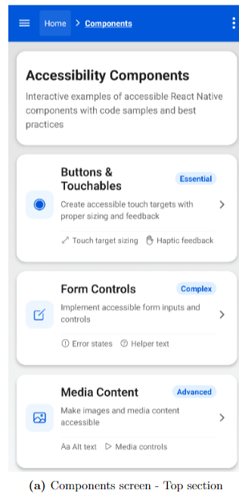
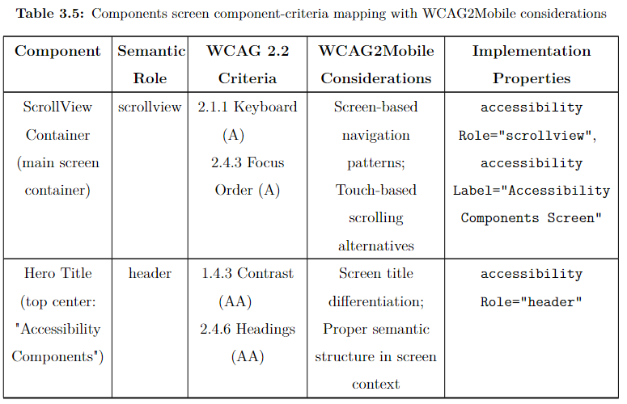
(1) Component-criteria mapping
G. Rovesti - Designing an accessibility learning toolkit
8/16

Slide 9
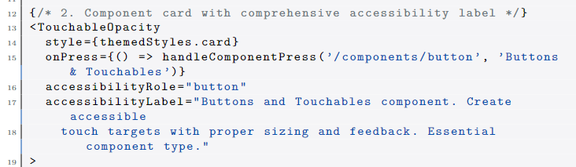
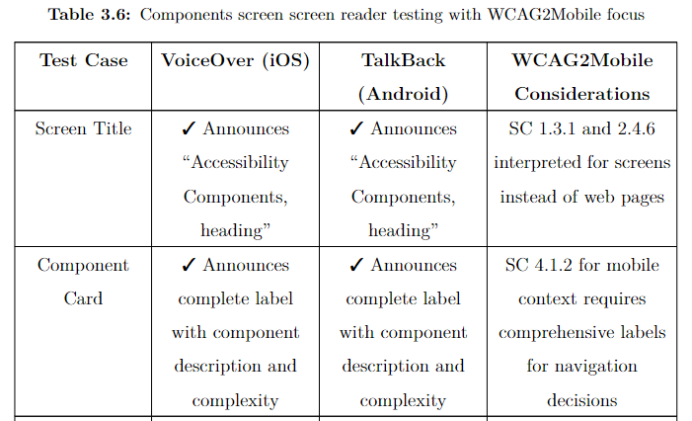
(2) Empirical screen reader testing
G. Rovesti - Designing an accessibility learning toolkit
9/16

Slide 10
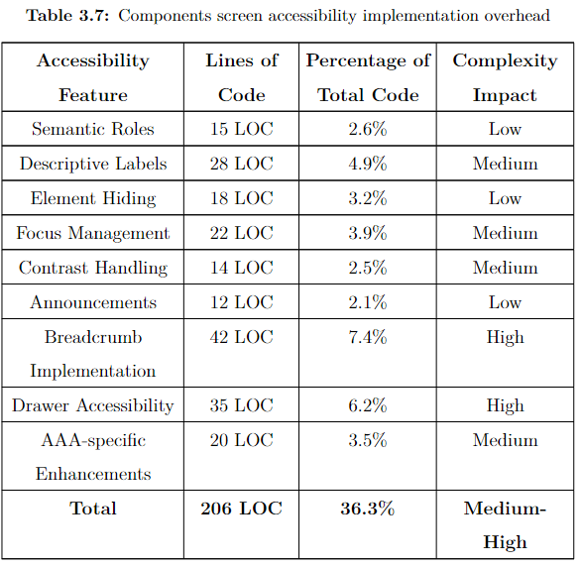
(3) Implementation overhead analysis
G. Rovesti - Designing an accessibility learning toolkit
10/16

Slide 11
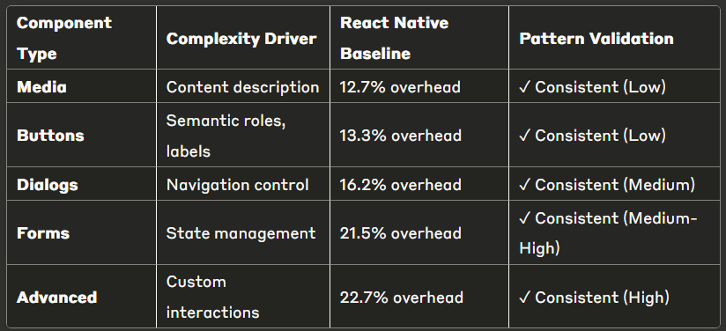
Component implementation patterns
Key finding: Systematic correlation enables predictable accessibility cost estimation across frameworks
Foundation for framework-agnostic accessibility cost prediction
G. Rovesti - Designing an accessibility learning toolkit
11/16

Slide 12

Formal evaluation metrics
Innovation: Evidence-based methodology for quantifying mobile accessibility implementation across frameworks
🔢 Implementation Overhead (IMO)
Direct code cost measurement for equivalent functionality
📱 Screen Reader Support Score (SRSS):
Likert scale based on VoiceOver/TalkBack functionality
✅ WCAG Compliance Ratio (WCR):
Standards adherence tracking (A/AA/AAA levels)
⚙️ Complexity Impact Factor (CIF):
Development difficulty classification (Low/Medium/High)
⏱️ Development Time Estimate (DTE):
Resource planning with complexity adjustments
G. Rovesti - Designing an accessibility learning toolkit
12/16

Slide 13
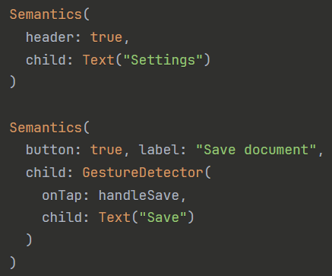
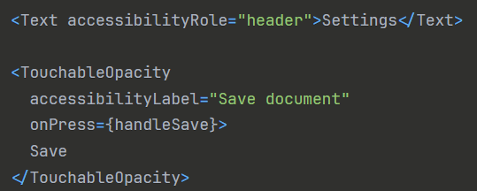

Frameworks comparison
Architecture differences:
React Native: Property-based model (accessibilityLabel, accessibilityRole)
Flutter: Widget-based approach (explicit Semantics wrappers)
🔵 React Native - Property integration
🔶 Flutter - Semantic wrappers
G. Rovesti - Designing an accessibility learning toolkit
13/16

Slide 14
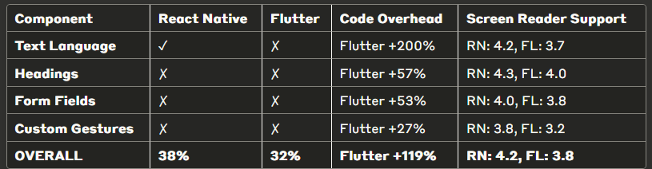
Framework comparison results (1)
✓ = Default accessibility support | ✗ = Requires developer implementation
Key patterns identified:
Text language declaration: Largest overhead difference (Flutter +200%)
Custom gestures: Smallest gap (Flutter +27%) - both frameworks struggle
Default accessibility: React Native provides more out-of-box features (38% vs 32%)
Screen reader consistency: React Native scores higher across all component types
G. Rovesti - Designing an accessibility learning toolkit
14/16

Slide 15
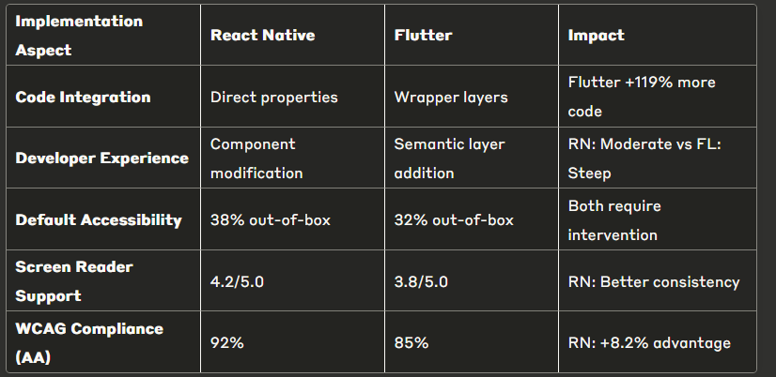
Framework comparison results (2)
Insights for development choice:
React Native for: Rapid development timeline, web accessibility knowledge, cross-platform consistency priority
Flutter for: Complex custom components, dedicated long-term maintenance team, granular accessibility control
G. Rovesti - Designing an accessibility learning toolkit
15/16

Slide 16


Research impact and conclusions
Key contributions:
Extended research framework from Flutter-only to comparative analysis
First quantitative framework for mobile accessibility cost assessment
Systematic methodology bridging WCAG theory to mobile practice
Research answers:
RQ1: No framework accessible by default (38% vs 32%)
RQ2: Both achieve 85-90% WCAG compliance with proper implementation
RQ3: React Native requires 45% less code for equivalent accessibility
G. Rovesti - Designing an accessibility learning toolkit
16/16

